Slide 1

Hybrid QAOA + Memetic Tabu Search for LABS Optimisation
Bridging quantum and classical algorithms to solve hard combinatorial problems

Slide 2

PROBLEM DOMAIN
Low Autocorrelation Binary Sequences
What Are LABS?
Low Autocorrelation Binary Sequences are binary strings optimised to minimise their autocorrelation energy—a measure of self-similarity at different shifts. Finding optimal LABS is NP-hard, making it computationally expensive as sequence length grows.
Why Hybrid Quantum–Classical?
Pure classical approaches struggle with local minima. Quantum algorithms can explore broader solution spaces, whilst classical refinement ensures practical convergence.

Slide 3
Original Plan: Direct LABS Hamiltonian
01
02
Implement LABS Hamiltonian in CUDA-Q
Run QAOA to Generate Candidates
Encode the autocorrelation energy function directly as a quantum Hamiltonian using Pauli operators.
Use the Quantum Approximate Optimisation Algorithm to sample promising bitstrings from the quantum state.
03
04
Seed Memetic Tabu Search
Compare Against Random Baseline
Feed QAOA-generated candidates into MTS, a classical local search algorithm with memory structures.
Benchmark QAOA-seeded MTS against randomly initialised MTS to measure improvement.

Slide 4
The Pivot: Simulator and Kernel Limitations
Challenge
Solution: QAOA
Direct LABS Hamiltonian implementation hit simulator constraints and kernel compilation issues in CUDA-Q.
We pivoted to a QAOA formulation to generate structured samples. Whilst not perfectly aligned with LABS energy, this approach maintains the hybrid workflow and provides non-trivial initialisation.
Simplified Hamiltonian encoding
Faster circuit compilation
Maintained probabilistic sampling properties
Preserved end-to-end hybrid pipeline

Slide 5
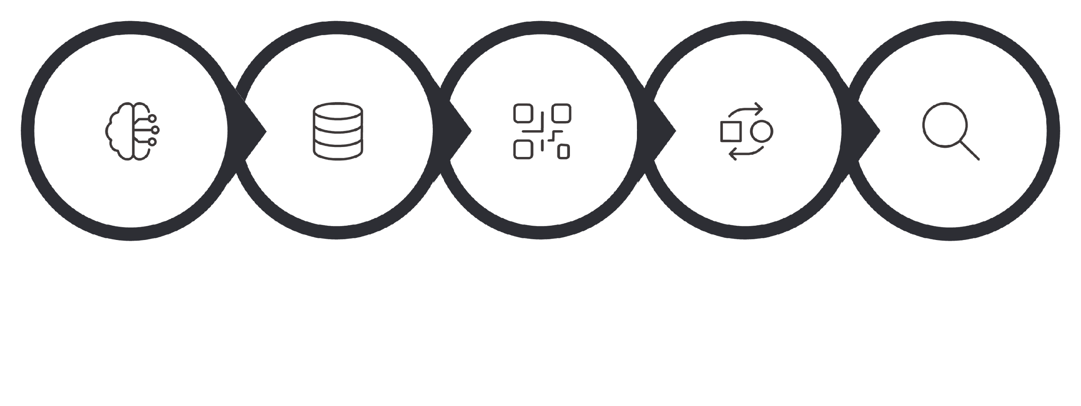





Hybrid Architecture Pipeline
Measurement Samples
Bitstring Conversion
Memetic Tabu Search
QAOA Circuit
±1 Mapping
The pipeline begins with QAOA sampling, converts bitstrings to ±1 sequences, then refines them using MTS to minimise autocorrelation energy. This workflow leverages quantum exploration and classical exploitation.

Slide 6
TECHNICAL DETAILS
QAOA and MTS Relationship
QAOA as Probabilistic Sampler
MTS as Classical Refinement
Cost Unitaries: RZZ, RYZZZ, RZZZY
QAOA encodes the cost function into a quantum circuit using alternating mixer and cost layers. Measurement yields bitstrings with probabilities biased towards low-energy configurations, providing diverse initialisation points.
Memetic Tabu Search combines local search with population-based evolution and tabu memory. It efficiently escapes local minima and converges to high-quality solutions when seeded with structured candidates.
QAOA cost layers implement Pauli-string interactions using multi-qubit rotation gates. These encode pairwise or higher-order correlations, creating entanglement that biases measurement outcomes towards favourable bitstring structures.

Slide 7
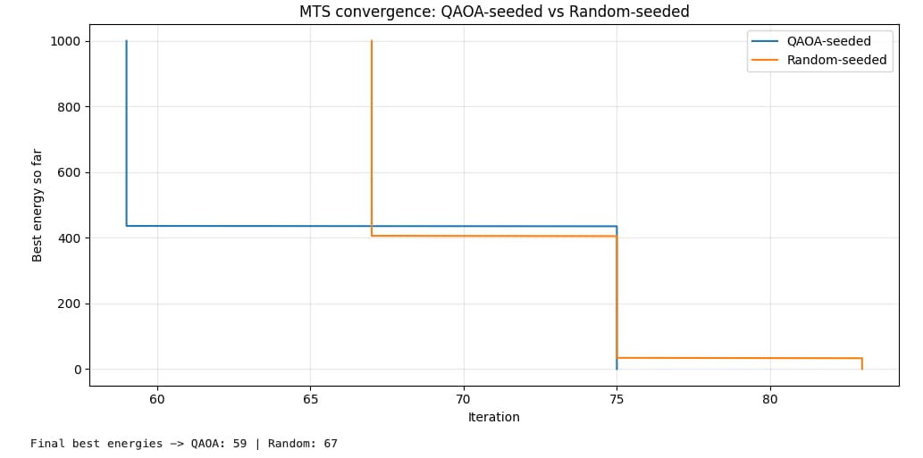
Our results :
We are showing graph that we generated .

Slide 8

Retrospective: Technical Takeaways
Hamiltonian Flexibility:Team member 1
Initialisation Over Complexity:Team Member 2
Things are not so messed up : Team Member 3
QAOA does not require perfect Hamiltonian modelling to provide value. Approximate or proxy cost functions can still yield useful structured samples for classical refinement.
High-quality initialisation consistently outperforms sophisticated optimisers started from random states. Quantum sampling provides this edge without needing optimal quantum solutions.
I learned that quantum algorithms are very much faster that classical . Optimization algorithms are way more good and faster.
Conclusion: QAOA-seeded MTS achieved lower LABS energy and faster convergence than random initialisation, demonstrating that hybrid approaches outperform purely classical baselines. Future work includes deeper QAOA circuits and hardware execution.

